Slide 1
Networks
CYB101
Unit 4

Slide 2
Welcome to Unit 4: Networks
Turn on your camera
Rename yourself with your pod number and full name:
6 - Montero Hill
Answer the question below in the chat:
What's one thing you wish you knew before starting your cybersecurity journey?
Notes:
TF Support Person Instructions: Add these directions listed in italics into the Chat.
Find your pod number here! https://courses.codepath.com/courses/cyb101/pages/groupings Fill out this survey for help with your Kali install! https://forms.gle/UT8pwS4STLdL3yBw8

Slide 3





As a community, we will...
Be present, physically and mentally
Actively build an inclusive community and space
Practice curiosity and adopt a learning mindset
Ask for help when we need it
Keep our cameras on

Slide 4
1 | Intro | 0:00 - 0:05
2 | Network Devices | 0:05 - 0:15
3 | Protocols | 0:15 - 0:35
4 | Network Vulnerabilities | 0:35 - 0:50
5 | Lab: DNS Tricks with Kali | 0:50 - 1:55
6 | Wrap Up | 1:55 - 2:00
Notes:
TF Support Person Instructions: Add these directions listed in italics into the Chat.
Here’s a link to the slides https://docs.google.com/presentation/d/1v0AAThoAyLWduroRZDiyaNAiDz3JmTy3YvBUEjENFnc

Slide 5
5 minutes
What happens when you enter a url like this one into a browser?
https://www.github.com
Notes:
Students will have a variety of answers. Some may be general like
It connects to the internet
It gets information from a server
It uses wifi
Jot down any technical concepts they come up with that connect to the lesson
routing, firewalls, MAC addresses, IP addresses, ARP packets, DNS & DHCP, etc.
Note that this is a common interview question

Slide 6
Network Devices
10 minutes
Notes:
TF Support Person Instructions: Add these directions listed in italics into the Chat.
Add your questions to #cyb101-s1-help-spring23 in slack https://codepath.slack.com/archives/C04P7KP2U0H Fill out this survey for help with your Kali install! https://forms.gle/UT8pwS4STLdL3yBw8

Slide 7
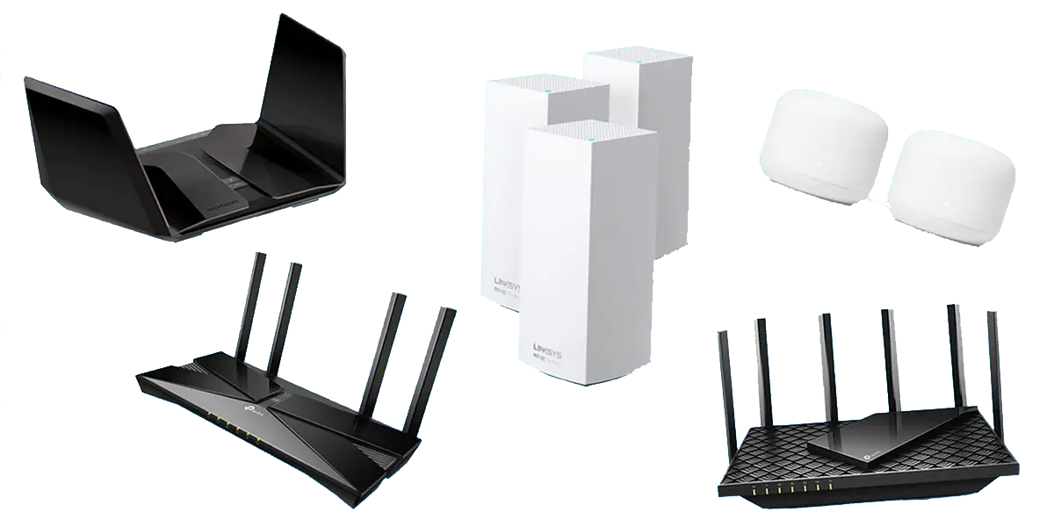
Routers
Communicates between internet and devices
Directs incoming & outgoing traffic in fastest possible way
Can provide network-level protection against cyberattacks
Operates on Network layer

Slide 8

Switches
Connects devices to create a network
Uses packet switching to receive and forward data
Operates on Data Link Layer

Slide 9
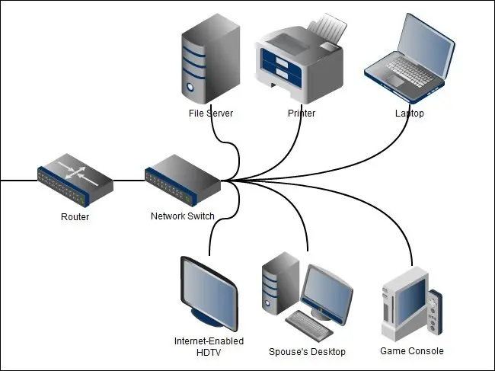
Routers vs Switches

Slide 10
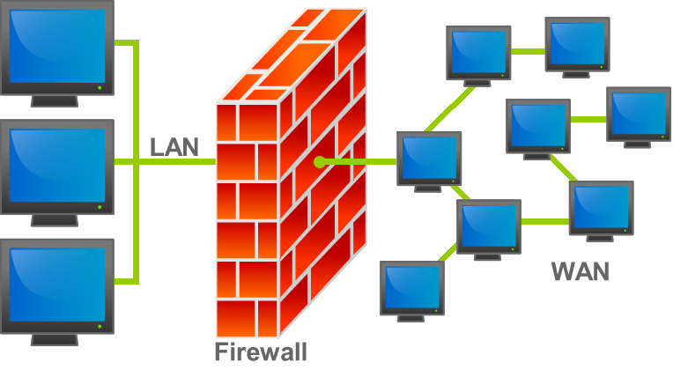
Firewalls
Network security system
Monitors and controls incoming & outgoing network traffic
Establishes a barrier between trusted & untrusted network

Slide 11
Load Balancers
Distributes network traffic across multiple servers
No single server receives is overloaded with demand
Improves application responsiveness & availability
(CIA Triad)
Helps prevent DDoS attacks

Slide 12
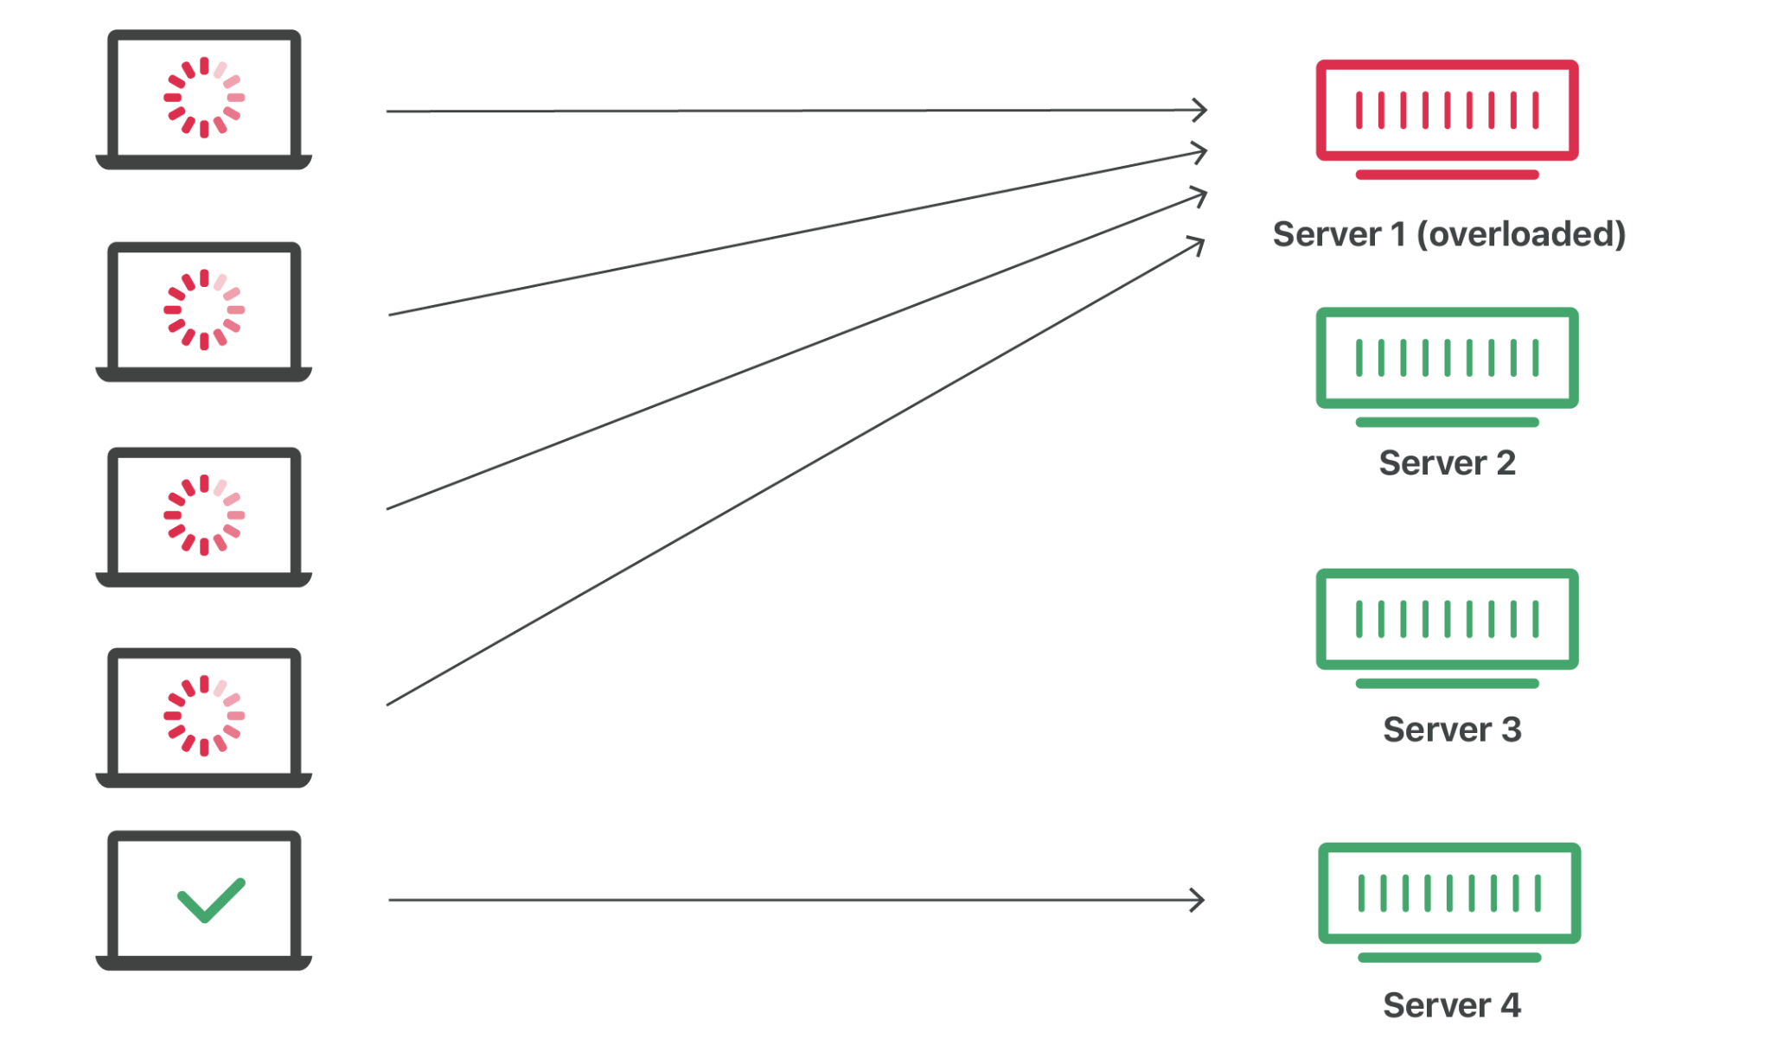
Network without Load Balancing

Slide 13
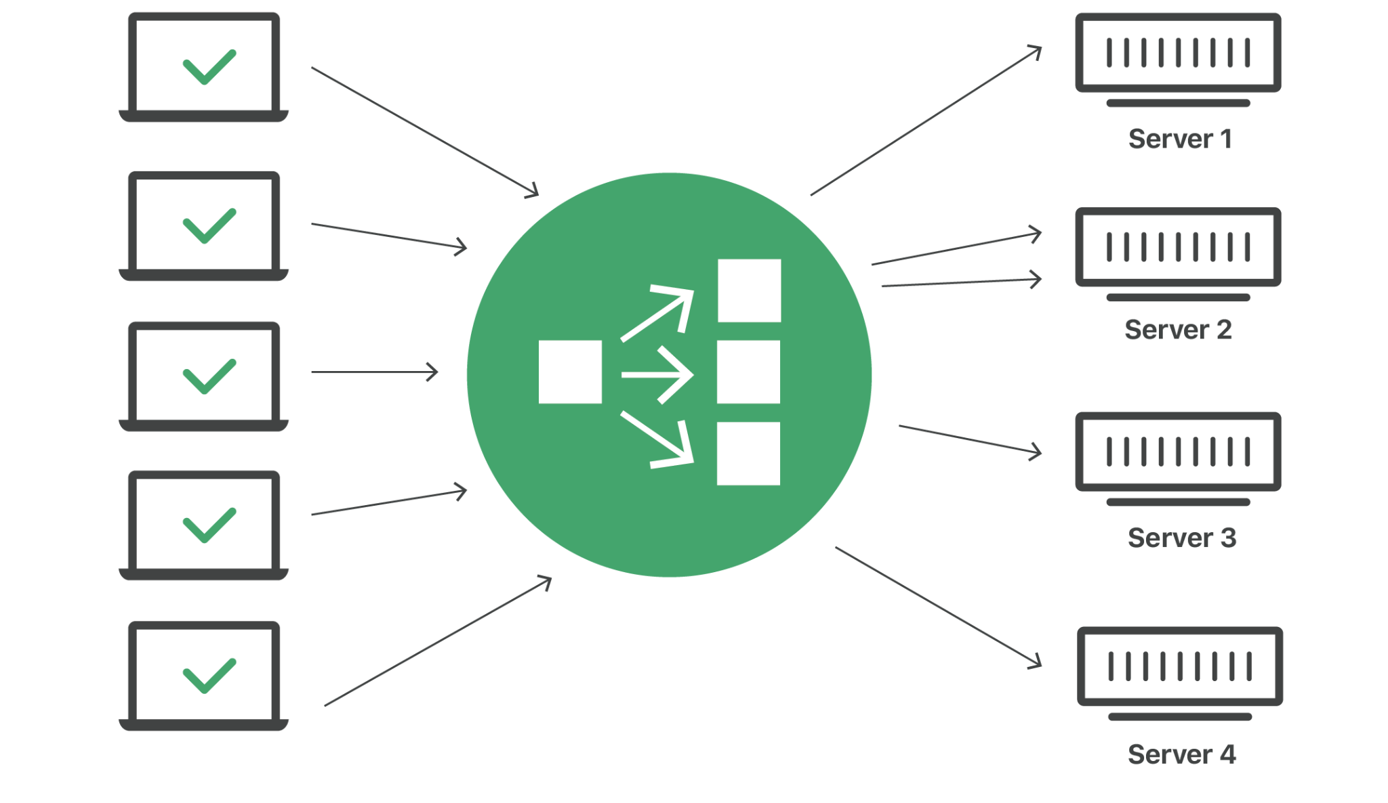
Network with Load Balancing
Notes:
TF Support Person Instructions: Add these directions listed in italics into the Chat.
Add your questions to #cyb101-s1-help-spring23 in slack https://codepath.slack.com/archives/C04P7KP2U0H Fill out this survey for help with your Kali install! https://forms.gle/UT8pwS4STLdL3yBw8

Slide 14
3 minutes
How can firewalls contribute to network security?
How can load balancers contribute to network security?
Notes:
Firewalls: creating a predefined set of rules that separates a trusted network from an untrusted network
Load balancers: preventing overloading of a server, preserving availability

Slide 15
Protocols
20 minutes

Slide 16
5 minutes
Display your network configuration using:
ipconfig command on Windows
ifconfig on Mac
What can you figure out about your network from this information?

Slide 17
Protocol: a set of implementation-agnostic rules for completing a task.
Notes:
TF Support Person Instructions: Add these directions listed in italics into the Chat.
Add your questions to #cyb101-s1-help-spring23 in slack https://codepath.slack.com/archives/C04P7KP2U0H Fill out this survey for help with your Kali install! https://forms.gle/UT8pwS4STLdL3yBw8

Slide 18
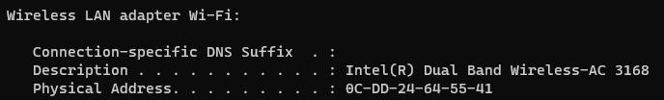
Media Access Control (MAC) Addresses
All computers in a “broadcast domain” receive all transmissions
MAC address indicates which computer data is intended for
MAC address is attached to data before broadcasting
Use ipconfig (Windows) or ifconfig (Mac) to find yours

Slide 19
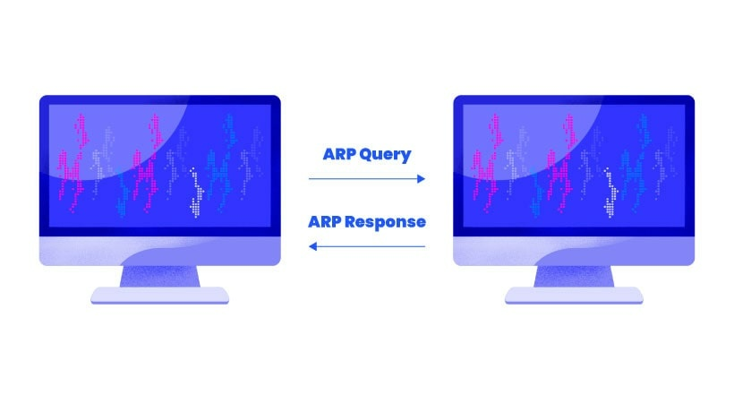
Address Resolution Protocol (ARP)
Protocol used for discovering MAC addresses from IP addresses
Sender asks for MAC address associated with IP
Computer with corresponding IP responds with MAC address
Who is 172.23.4.1 ?
I am! My MAC address is 111.222.333

Slide 20
Domain Name System (DNS)
Translates domain names (e.g. docs.google.com) to IP addresses
Let’s look at the steps of DNS resolution …

Slide 21
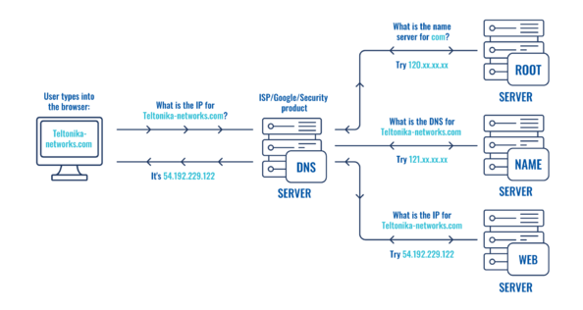
DNS Resolution

Slide 22


DNS Resolution
Browser requests to visit github.com
Company or local DNS is checked

Slide 23

DNS Resolution
Browser requests to visit github.com
Company or local DNS is checked
If IP is not found, ISP DNS is checked next

Slide 24

DNS Resolution
Browser requests to visit github.com
Company or local DNS is checked
If IP is not found, ISP DNS is checked next
If IP is not found, root DNS is checked next

Slide 25
DNS Resolution
github.com data is returned to browser
Browser requests to visit github.com
Company or local DNS is checked
If IP is not found, ISP DNS is checked next
If IP is not found, root DNS is checked next
Notes:
TF Support Person Instructions: Add these directions listed in italics into the Chat.
Add your questions to #cyb101-s1-help-spring23 in slack https://codepath.slack.com/archives/C04P7KP2U0H Fill out this survey for help with your Kali install! https://forms.gle/UT8pwS4STLdL3yBw8

Slide 26
Dynamic Host Configuration Protocol (DHCP)
Server that automatically assigns IP addresses and other network parameters
Device requests IP from DHCP server to access network
DHCP server monitors use of addresses and can revoke them
Reduces network administration & minimizes address conflicts and other errors

Slide 27
Routing
Process of selecting a path for traffic within and between networks
Algorithms are used to optimize routing
Distance vector
Link-state
Optimized Link State
Path-vector
Network acts autonomously to avoid failure and blockages

Slide 28
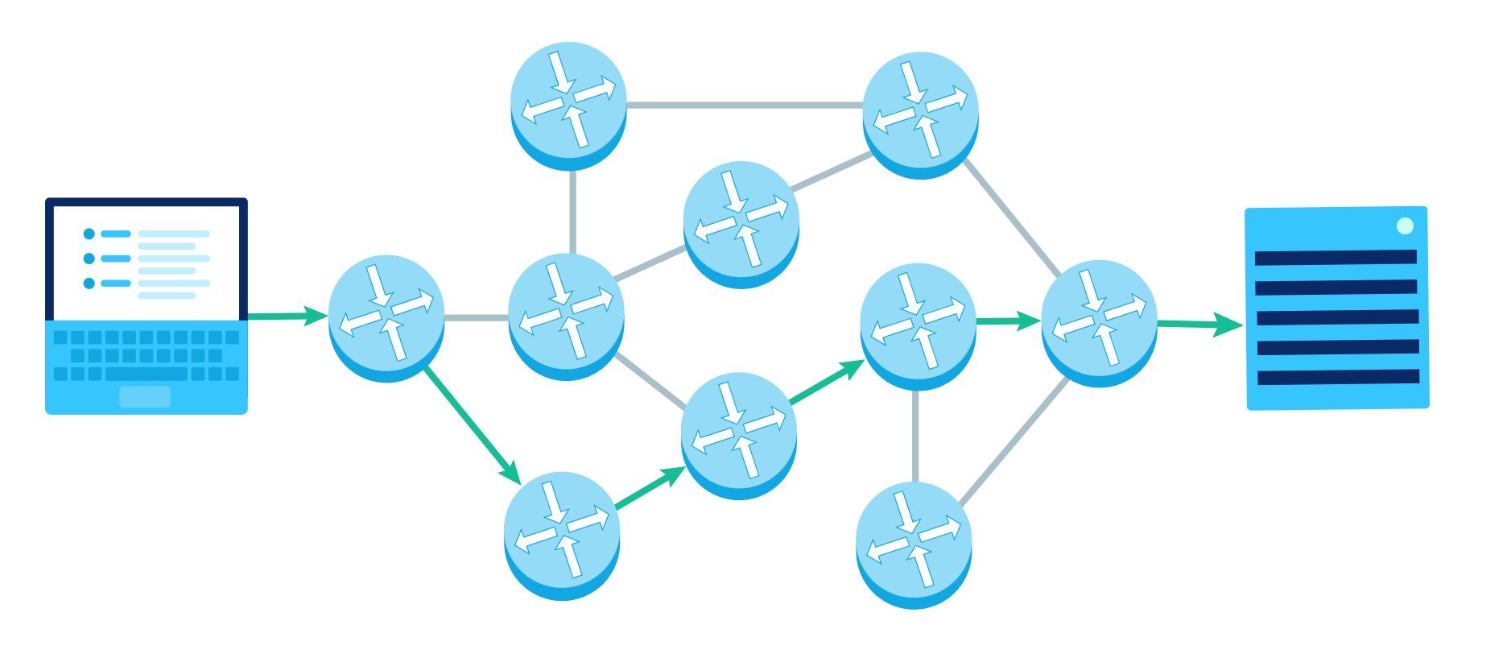
Routing Example

Slide 29
Border Gateway Protocol (BGP)
A routing protocol
Not all networks belong to the same organization
BGP accounts for business considerations, e.g. charges for carrying traffic

Slide 30
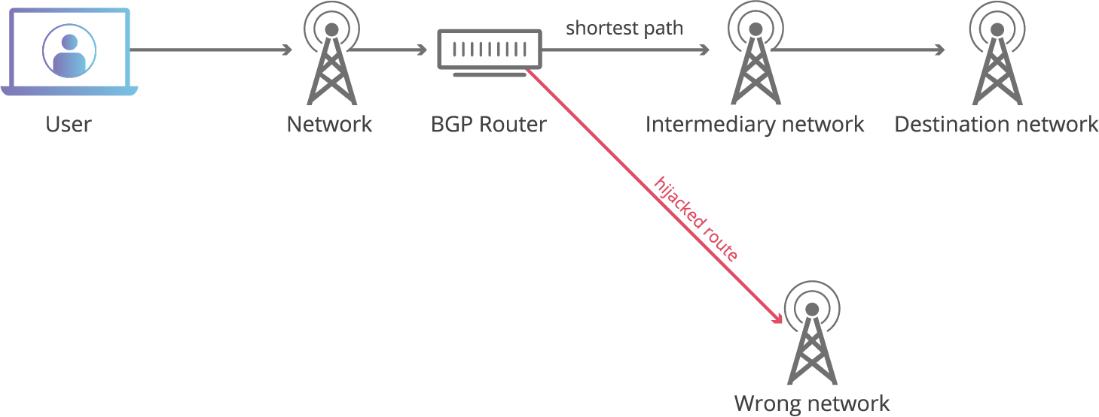
BGP Hijacking
BGP route-sharing relies on trust
Networks implicitly trust routes shared with them
Hijacking: attackers maliciously reroute internet traffic
Falsely announce ownership of groups of IP addresses

Slide 31
Network Vulnerabilities
15 minutes

Slide 32
Network intrusion: unauthorized access of a computer or address within an assigned domain.

Slide 33
Network Intrusion Detection
Monitoring a network for malicious activity
Wide range, including antivirus software and tiered monitoring systems
Signature detection: detects possible threats by looking for specific patterns, such as byte sequences in network traffic, or known malicious instruction sequences
Anomaly-based detection: detects and adapts to unknown attacks, especially useful due to increase in malware

Slide 34
Prevention Strategies
Network intrusion prevention system: monitors all network traffic and proactively scans for threats
Host intrusion prevention system: installed on an endpoint, looks at inbound & outbound traffic from that device only
Last line of defense
Network behavior analysis: detects unusual traffic flows, spots zero-day vulnerabilities
Wireless intrusion prevention system: scans WiFi network for unauthorized access
Notes:
TF Support Person Instructions: Add these directions listed in italics into the Chat.
✅If you don’t have Kali Installed goto the breakout room called "With NO Kali Installed"

Slide 35
Analysis of Network Traffic
Continuous collection of real-time and historical network data
Detecting malware
Detecting vulnerable protocols and ciphers
Eliminating blind spots in the network

Slide 36
Distributed Denial of Service (DDoS)
Flooding a service with an overwhelming amount of traffic in an attempt to take the service offline
Identifying a DDoS attack:
High volume of traffic from one IP address or IP range
Flood of traffic from users with a similar profile e.g. device type
Unexplained surge in requests to a single endpoint
Spikes of traffic at odd hours

Slide 37
Mitigating DDoS Attacks
Key idea: differentiate between attack traffic & normal traffic
Blackhole routing: funnel traffic into a null route
Makes network inaccessible for all
Rate limiting: limit the number of requests a server accepts in a given timespan
Struggles to handle a multi-vector DDoS
Traffic scrubbing: traffic is redirected to a datacenter and cleaned before forwarding to original destination
Notes:
TF Support Person Instructions: Add these directions listed in italics into the Chat.
✅If you don’t have Kali Installed goto the breakout room called "With NO Kali Installed"

Slide 38
Break Time!
Take 5 mins to step away from the computer. Feel free to turn off your camera and return promptly after 5 mins.

Slide 39
Lab: DNS Tricks with Kali
65 minutes

Slide 40
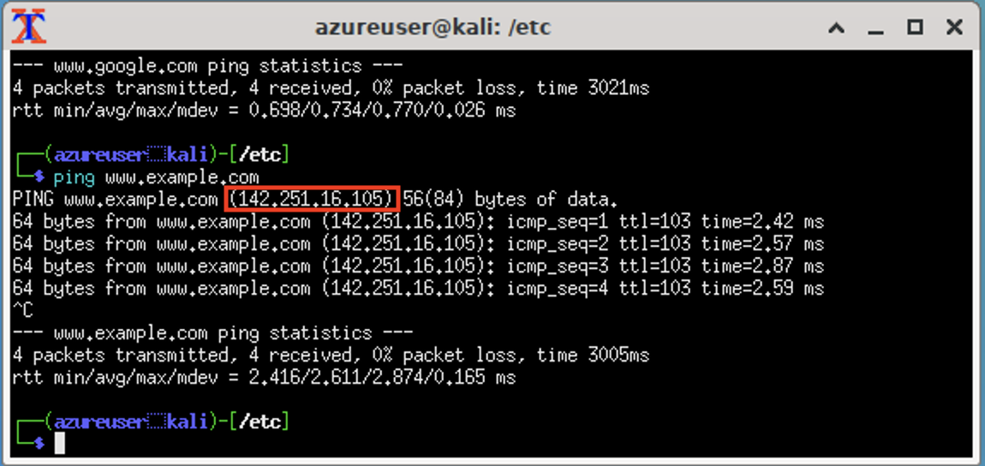
Lab: DNS Tricks with Kali
Modify HOSTS file
Use networking commands to see DNS resolution change

Slide 41
60 minutes
Navigate to the Lab tab in the course portal
Complete the Lab!
@[handle]

Slide 42
Wrap Up
5 minutes

Slide 43
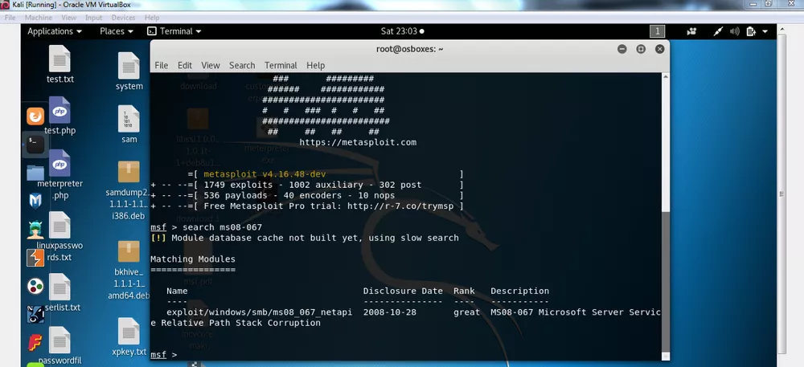
Project Preview: Attacking a Webserver VM
Use Metasploit to create a payload & exploit a known vulnerability on a target

Slide 44
Before you leave...
Complete the Session Survey (5 minutes)
Complete Early Course Survey
Reminder: complete the Project before next session!
Next session: Malware 👾
Notes:
TF Support Person Instructions: Add these directions listed in italics into the Chat.
Add your feedback here! https://www.surveymonkey.com/r/connclass-spring2023-earlysurvey

